Slide 1

DogMate Ori Adika, Omri Muadi, Gil Eden, Yuval Genislav
Software Engineering
Faculty of Engineering
Ben Gurion University of the Negev

Slide 2
DogMate
Student Name | ID | Email | Phone | Signature
Ori Adika Yuval Genislav Gil Eden Omri Muadi | 209200559 313555187 207449745 214036865 | oriadik@post.bgu.ac.il genislav@post.bgu.ac.il Gilede@post.bgu.ac.il muadiom@post.bgu.ac.il | 054-811-2141 053-276-7779 050-985-5332 050-623-4046 | Ori Adika Yuval Genislav Gil Eden Omri Muadi
DogMate
חברי ה-כלב

Slide 3
Customer
Customer Name
Customer Representative Person
Role
Email
Phone Number
Address
More Advisors?

Slide 4
Introduction
DogMate - Your Smart Companion for Managing Your Dog’s Life
DogMate is a smart, all-in-one app that makes dog ownership simpler, more organized, and stress-free.
Manage everything in one place — feeding, walks, health, reminders, and activity tracking — through an easy-to-use interface.
Each dog has a personal profile with details like name, breed, and weight.
The app supports shared walks, smart reminders, and useful reports to track your dog’s health and routine. With DogMate, everything stays organized so you can enjoy more quality time with your best friend. 🐾

Slide 5
Project’s Motivation and Purpose
Motivation
Managing a dog’s daily routine — feeding, walks, vaccinations, and medical care — can be time-consuming and unorganized.
Information is often spread across notes, chats, and different apps, leading to missed reminders and inconsistent care.
DogMate was created to solve this problem — a smart, centralized app that brings together all your dog’s information, reminders, and activities in one place.
Our goal is to make dog ownership simpler, more organized, and focused on your dog’s well-being and connection. 🐾

Slide 6
Project’s Motivation and Purpose
Problem
Scattered and Unorganized Information Dog owners often use multiple apps, notes, or memory to manage feeding, walks, and medical care — leading to disorganization and lost data..
Missed Health and Care Routines Without a unified reminder system, important events like vaccinations or treatments are easily forgotten, impacting the dog’s health.
Limited Collaboration and Sharing When several family members share responsibility for a dog, there’s often no easy way to coordinate activities, record updates, or share information in real time.
Lack of Insights and Tracking Owners rarely have an easy way to monitor their dog’s habits, activity levels, or weight over time, making it harder to spot health patterns or behavioral changes early.

Slide 7
Project Description
Elevator
Mobile App – all your dog’s information, care, and walks in one place, while connecting you with other dog owners nearby.
Things That Will Be Developed
Mobile App: modern UI, user-friendly interface with push notifications.
Data model: users, dogs, treatments / vaccines, events / reminders, walks, contacts, weights and documents.
Maps Integration: Real-time map view showing nearby dog owners, shared walking routes, and location-based interactions (Google Maps API).

Slide 8
Project Description
Core Functionalities
Dog Profile: name, photo, breed, sex, birth date, microchip, wight log, notes.
Walks: start / stop tracking, basic stats(duration, walking radius), "shared walk" invite for group participation.
Calendar & Reminders: add events (feeding, vet visit, grooming, meds, custom), recurring rules, snooze / mark-done and push alerts.
Health & Vaccinations: treatment records, due-date calculation, auto-generated reminders.
Contacts: vet, pet store.

Slide 9

Project Features
Dog Matching
Our app integrates with pawsavvytech.com, which provides an intelligent algorithm for dog matching. The matching system analyzes each dog’s profile data — such as pet type, age, size and gender — to find compatible playmates or potential matches.
This feature enhances user engagement by enabling owners to connect their dogs with others of similar characteristics, promoting social interaction, healthier activity, and a personalized user experience.

Slide 10
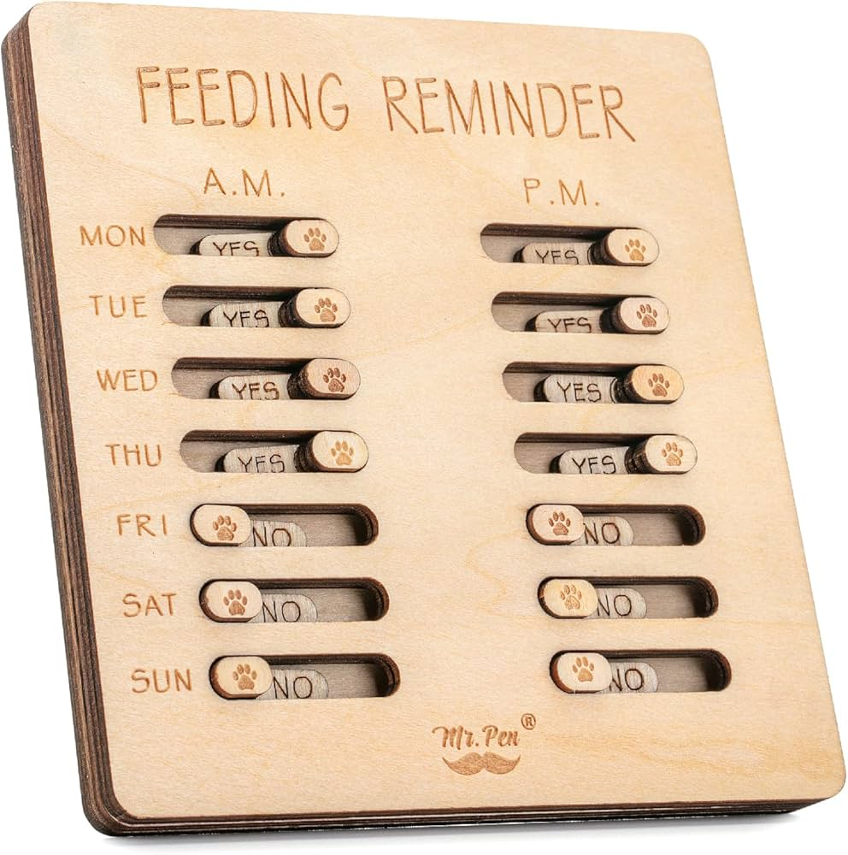
Project Features
Dog Reminders
This feature helps dog owners stay organized and never miss an important activity in their dog’s routine.
Users can easily set custom reminders for daily or recurring tasks such as feeding, medication times, vet appointments, grooming sessions, and walks. Each reminder can be linked to a specific dog in the app, ensuring personalized schedules for multi-dog owners.
The app sends smart notifications — including alerts 15 minutes before an event and at the scheduled time — to help owners prepare in advance.
Additionally, users can create new reminder types beyond the predefined options, giving them full flexibility to adapt the app to their dog’s unique needs.

Slide 11

Project Features
Dog Walker
This feature displays the number of available dog walkers in each city.
It allows users to quickly view phone number of available dog walkers and their availability hours, (dog walkers have option to activate/deactivate their activity)

Slide 12
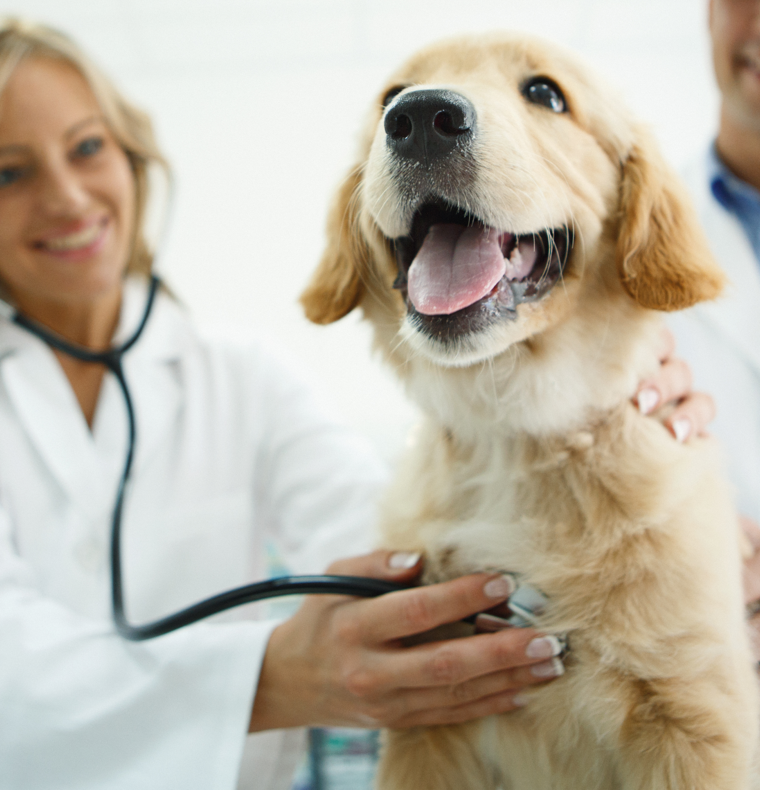
Project Features
SOS & Utility Module
This feature provides a dedicated emergency hub for dog owners to act quickly when urgent situations occur.
Users can store and access key contacts — such as their primary vet, emergency clinics, and trusted caregivers — all in one place.
The module includes a real-time map that helps locate nearby open veterinary clinics instantly, ensuring fast response in critical moments.
With one tap, owners can call for help or navigate to the nearest clinic, making this feature an essential safety tool for every dog owner.

Slide 13

Project Features
Dog Documents
This feature lets owners store and manage all their dog’s important files in one place — such as vaccination records, vet visit summaries, insurance papers, and travel documents.
Each file can be linked to a specific dog, making it easy to stay organized with multiple pets.
Everything is securely saved and accessible anytime, so owners can quickly find and share documents when needed.

Slide 14
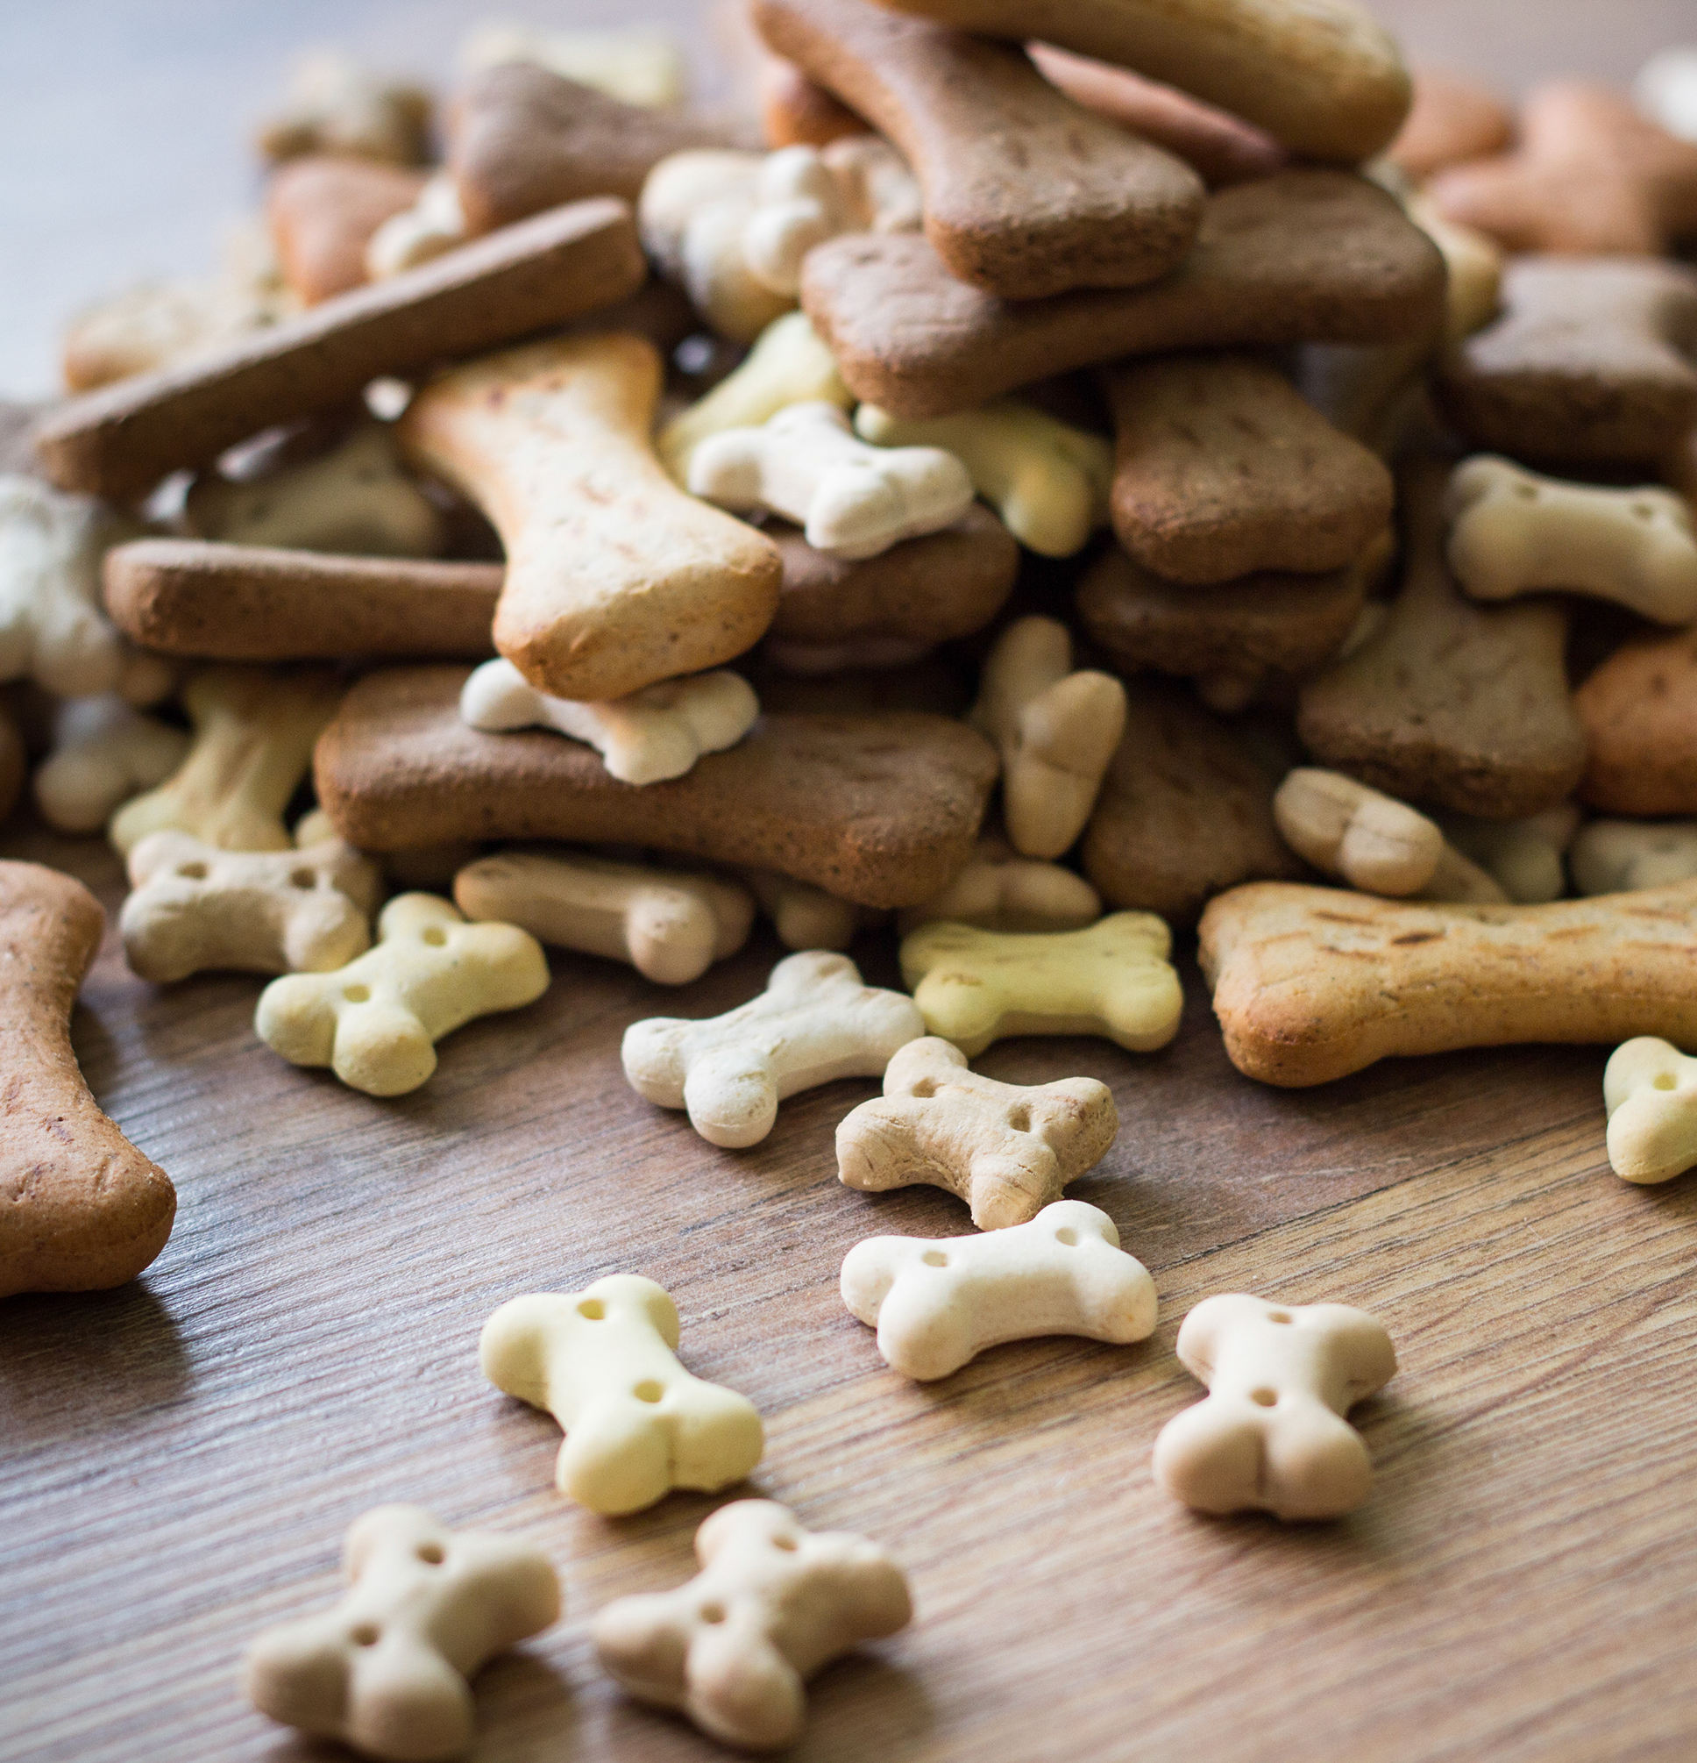
Project Features
Food Intake
This Feature help dog owners manage their dog’s food supply and make sure their dog never runs out of food unexpectedly and will send him notifications in advance.

Slide 15
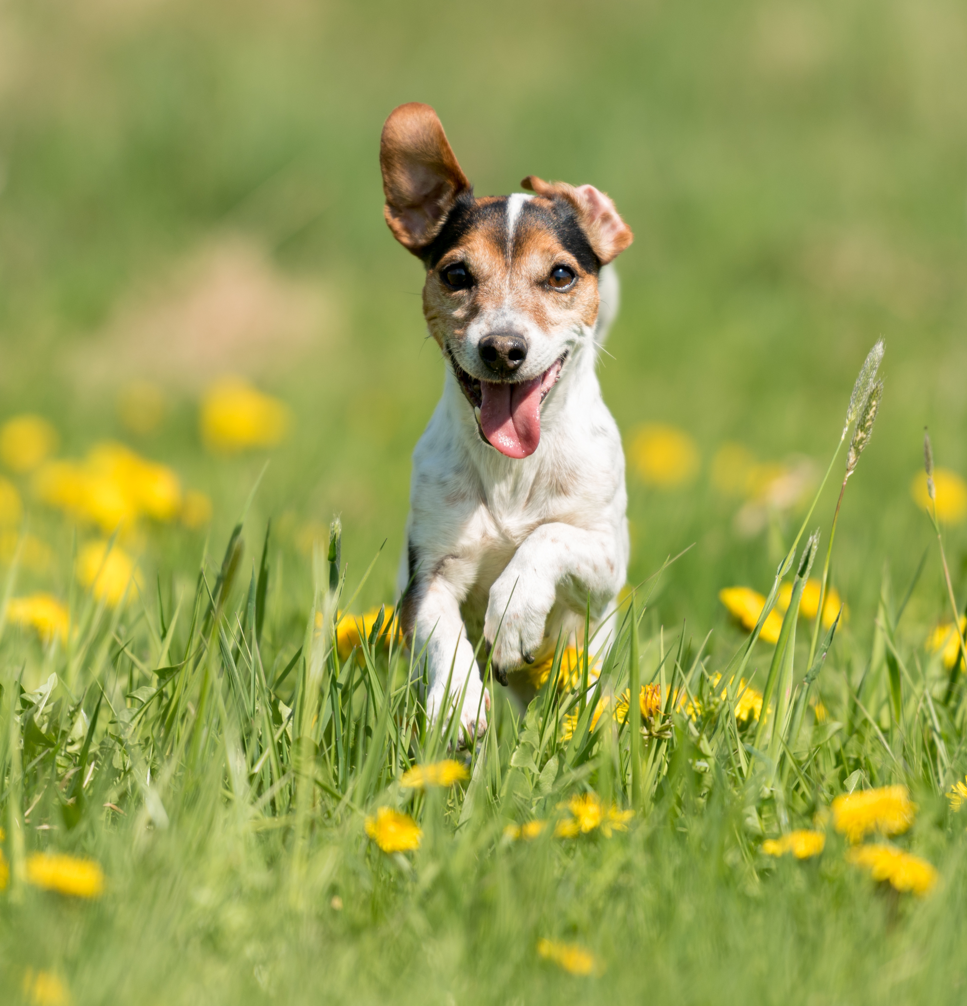
Project Features
Mood Characteristics of the Dog
This feature allows continuous monitoring and analysis of a dog’s mood based on behavioral patterns, activity levels, and daily routines.
enables mood tracking and visualization, helping owners better understand their dog’s well-being and detect early signs of discomfort or behavioral changes.

Slide 16
Customer – what exists? What provides?
High-Level Requirements
1. Social & Geolocation Module
Live Map: A central map displaying two types of entities:
Other users who are currently in "walk mode."
Static Points of Interest (POIs), specifically "dog parks."
"Go for a Walk" Mode: A toggle for users to broadcast their location and availability for a social walk.
Social Interaction Flow:
"SNIFF" (Request): A user can tap on another user on the map to request to join their walk.
"TAIL WAVING" (Accept): The receiving user can accept the request, allowing them to meet.
"Not This Time" (Decline): The receiving user can decline the request.
Profile Preview: Tapping a user on the map must show essential dog details (type, age, breed, gender) to help owners make informed social decisions.

Slide 17
Customer – what exists? What provides?
2. Digital Dog Profile Module
Core Details: A "digital ID" for the dog, including identifying information (breed, age, gender, name, etc.).
Document Management: A secure "digital binder" for users to upload and store important documents:
Vaccination records.
Pet insurance policies.
Event Scheduling: An in-app calendar to manage the dog's schedule.
Must support one-time events (e.g., "Next Vet Appointment").
Must support recurring events (e.g., "Daily Feeding Times," "Daily Walk Times").
3. Notification & Reminder System
Dual-Alert Logic: The system must be capable of sending two distinct push notifications for any scheduled event:
Pre-Event Alert: A notification sent 15 minutes before the scheduled event.
Event-Time Alert: A notification sent at the exact time of the scheduled event.

Slide 18
Customer – what exists? What provides?
4. SOS & Utility Module
A dedicated "Emergency" section in the app.
Storage for key contacts (Primary Vet, Emergency Vet).
A map function to "Find Nearby Open Clinics."

Slide 19
Customer – what exists? What provides?
Competitor Gap Analysis (DOGMATE vs. "PawMates")
What the competitor ("PawMates") has:
Basic Social Network: User profiles (noted as "unsecured" and allowing "incorrect details") and a user-to-user chat function.
What the competitor is missing (and what DOGMATE will provide):
1. Health & Admin Module ("Digital Dog Binder")
No Document Storage: It lacks a feature to upload or store critical documents (e.g., vaccination records, insurance policies).
No Schedule Management: It does not have a calendar for future appointments (e.g., vet visits) or recurring events (e.g., feeding times).
2. Emergency & Geolocation Module (SOS & POI)
No Live Clinic Finder: It cannot locate nearby, open clinics in real-time.
No POI Map: It does not have a map layer showing points of interest like dog parks.
3. Live Social Module ("Social Walk")
No Real-Time Availability: It lacks the core DOGMATE feature of seeing who is currently walking nearby.
No Meet-up Function: It does not have the "SNIFF" / "TAIL WAVING" functionality to request and accept real-time social walks.

Slide 20
Competitor DogMate vs PawMates
Gap Analysis (DOGMATE vs. "PawMates")
Basic Social Network: PawMates provides user profiles (noted as unsecured and allowing incorrect details) and a user-to-user chat function. DOGMATE goes beyond this with a Live Social Module, enabling owners to see who is currently walking nearby and use “SNIFF” / “TAIL WAVING” to request or accept real-time social walks, without user to user chat.
Health & Admin Module (Digital Dog Binder): PawMates lacks document storage and does not allow users to upload or manage critical files like vaccination records or insurance policies. It also has no schedule management, missing features like calendars for vet visits, medication times, or recurring events. DOGMATE provides full document management and smart scheduling for every dog.
Emergency & Geolocation Module (SOS & POI): PawMates cannot locate nearby, open clinics and does not include a map layer for dog parks or points of interest (POIs). DOGMATE includes a dedicated SOS hub, giving instant access to primary vets, emergency clinics, and live clinic locations, along with a map to navigate to the nearest open veterinary service.

Slide 21
Competitor DogMate vs Doglog
Gap Analysis (DOGMATE vs. DogLog)
Social and Map Integration : DogMate integrates Google Maps to display nearby dog owners and enables real-time social walks features. DogLog does not include social interaction or live map functionality.
Smart Automation and Notifications : DogMate provides smart reminders, including feeding alerts, mood tracking, and food restock notifications. DogLog relies on manual event logging without automated predictions or reminders.
Health & Admin Module: DOGMATE allows document storage for vaccination records, insurance policies, and vet visit summaries, all linked to each dog profile. DogLog does not offer document management or schedule tracking for recurring events.
Emergency Module (SOS): DOGMATE includes a dedicated SOS hub where owners can quickly access key contacts such as their primary vet and emergency clinics. DogLog lacks direct access to emergency contacts.
Advanced Features :
DogMate includes several unique capabilities not found in DogLog: 1. Dog Matching (via pawsavvytech.com)
2. Dog Walker Directory (number of walkers by city)
3. Smart Food Intake Tracking with notifications and refill reminders

Slide 22
Project’s Risk Assesment (and how to overcome)
Challenge | How to overcome?
User Safety & Liability The app actively encourages in-person meetings between strangers and their dogs. This creates a risk of negative encounters, dog fights, or personal safety issues, which could lead to legal liability. | Implement Strong Safety & Moderation Tools: 1. Report/Block System: A prominent and easy-to-use "Report User" and "Block User" function. 2. Safety Disclaimer (TOS): A clear Terms of Service (TOS) that users must accept, stating that DOGMATE is not responsible for real-world interactions. 3. Safety Onboarding: Show "Safe Meet-up Tips" to users before they use the "SNIFF" feature for the first time.

Slide 23
Project’s Risk Assesment (and how to overcome)
Challenge | How to overcome?
Feature Creep & Over-Complexity The project combines many modules (Social, SOS, POI, Reminders). The risk is that the app becomes bloated, confusing for the user, and too complex to build, test, and maintain effectively. | Implement a Phased, MVP-First Approach: 1. Prioritize the Core Loop: Launch with a Minimum Viable Product (MVP) focused on only the core "Digital Dog Binder" (profiles, docs, reminders) and the "SOS/POI" (dog parks, clinics map). This provides immediate, standalone value. 2. Phase 2 Rollout: Introduce the "Live Social Walk" ("SNIFF") feature only after building a stable user base that is already engaged with the utility features. This separates technical and market risks.

Slide 24
Project’s Risk Assesment (and how to overcome)
Challenge | How to overcome?
Data Privacy & Security Breach The app will store highly sensitive user data: personal documents (insurance, vet records) and live, real-time user location. A data breach would be catastrophic for user trust and brand reputation. | Adopt a "Security by Design" Policy: 1. End-to-End Encryption (E2EE): Encrypt all sensitive documents and user location data, both at rest (on the server) and in transit (from the app). 2. Location Fuzzing: Consider "fuzzing" or slightly obscuring a user's exact location when they are near their designated "Home" address to prevent stalking. 3. Minimal Permissions: Only request location access when the user activates "Go for a Walk" mode, not 24/7.

Slide 25
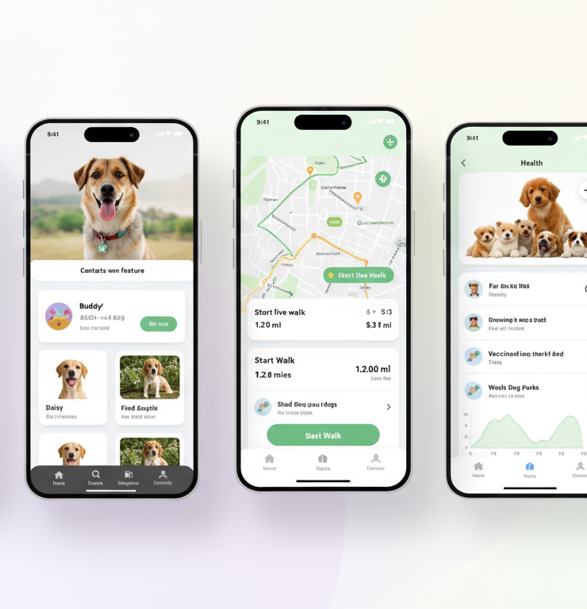
User Interface
🐾 UI - DogMate – Your Dog’s Smart Companion
1. Personal Area Create a dog profile with name, age, breed, and photo. Warm, personal design to strengthen the owner–pet bond.
2. Health & Vaccinations Track vaccinations, vet visits, treatments, and feeding. Includes reminders, progress bars, and organized visuals.
3. Walk Tracker (Main Feature) Start a walk in two taps with live GPS tracking. View your route, distance, and nearby dogs on the map.
4. Contacts Store and access key contacts — vet, groomer, sitter, friends. Quick call or message directly from the app.
5. Reports & Activity Logs Generate weekly summaries of walks, weight, and activity. Clear charts and visual insights to track progress.

Slide 26
Project’s Environments and Langugaes
Frontend
React Native (TypeScript), React Navigation
Maps: react-native-maps with provider="google" (Google Maps SDK for Android)
Location: Fused Location Provider via expo-location (foreground/background)
UI/state: React Query + Zustand/Redux Toolkit
Notifications: expo-notifications (FCM)
Media: expo-image-picker → upload via presigned URL
Backend (API)
Python FastAPI, Uvicorn/Gunicorn
Auth: OAuth2 + JWT (access/refresh), roles (owner, family)
Data: SQLAlchemy 2.0 + Alembic; PostgreSQL (optionally PostGIS for geo)
Storage: S3/MinIO for dog photos
Background jobs: Celery + Redis (scheduled reminders, push triggers)
Database
PostgreSQL 15/16

Slide 27
Evaluation and Testing Plan
Unit tests (Frontend): Jest + React Native Testing Library for components, hooks, form validation, state (Zustand/Redux).
Unit tests (Backend): pytest (+ pytest-asyncio) for services, repositories, and utilities; schema validation with Pydantic models.
API/Integration tests: pytest + httpx against FastAPI; test auth (JWT), role permissions (owner/family), pagination, and error codes.
Database & Migrations: transactional tests on a Postgres test DB; Alembic migration up/down tests.
Maps & Location tests: mock location provider; verify permission flows, marker rendering, polyline decoding, throttled updates.

Slide 28
Evaluation and Testing Plan
E2E (Mobile): Detox scenario: login → create dog → start walk (live location) → stop → reminder created → push notification received.
Background jobs: Celery worker tests with Redis; scheduled reminder logic and FCM push trigger paths.
Security checks: auth required on protected routes, JWT expiry/refresh, rate-limit endpoints, CORS, and file upload validation (S3/MinIO).
Performance & reliability: measure cold start and map screen FPS; backend p95 latency & throughput (k6/Locust); crash monitoring with Crashlytics/Sentry.
Accessibility & usability: TalkBack labels, color contrast; small user study (5–8 users), SUS ≥ 75 and task completion time targets.

Slide 29
Team Roles & Responsibilities
Team Lead / Version Manager (Lead + Git & Documentation) Responsibilities:
Acts as project lead and main point of contact with the client.
Manages Git workflow: reviews and approves PRs, handles merges, resolves conflicts.
Ensures proper documentation is maintained for code, features, and design decisions.
Organizes and monitors task progress, ensuring deadlines and milestones are met.
Facilitates team communication, assigns tasks, and supports developers when needed.

Slide 30
Team Roles & Responsibilities
Backend Developer 1 – Data Layer & Domain Layer Responsibilities:
Responsible for Data Layer: database design, ORM models, and data structure.
Handles Domain Layer: core business logic related to dogs, reminders, documents, and schedules.
Writes unit tests to ensure data and business logic correctness.
Collaborates with Backend Developer 2 to ensure data consistency across layers.

Slide 31
Team Roles & Responsibilities
Backend Developer 2 – Repository & Business Service Layer Responsibilities:
Manages Repository Layer: data access, database queries, and integration with Domain Layer.
Handles Business Service Layer: advanced features like notifications, real-time social walks, SOS/emergency logic.
Implements API endpoints and ensures proper integration with Frontend/UI.
Focuses on performance, scalability, and maintainability of backend services.

Slide 32
Team Roles & Responsibilities
Frontend / UI Developer Responsibilities:
Develops the mobile application interface and user experience (UI/UX).
Connects frontend components to backend APIs for features like reminders, social walks, maps, and documents.
Implements responsive and intuitive design, ensuring smooth UX for multiple devices.
Works closely with Team Lead to implement features according to specifications and design guidelines.

Slide 33
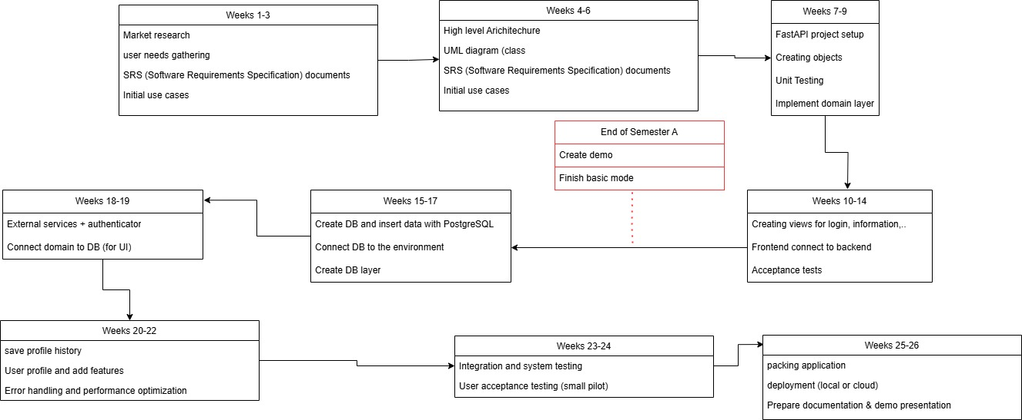
Project’s Steps and Timeline

